Slide 1
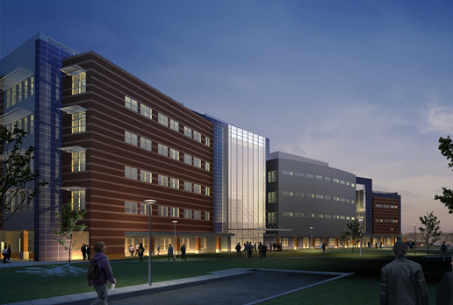
University Academic Center
Eastern USA
Alexander Altemose I Structural Option

Slide 2
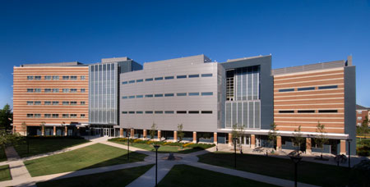
University Academic Center
Introduction
  General Information
  Building Layout
  Current Structure
Proposed Goals
Structural Depth
Construction Breadth
Conclusion
General Information
Height: 72 ft (5 floors)
Size: 192,000 sf
Function: Mixed use (A-3, B, S-1)
Construction: September 2005 – August 2007
Cost: $55.7 million
LEED Rating: Gold
Project Team
Owner: (wishes to remain anonymous)
Architect / Engineer: Cannon Design
Construction Manager: Skanska USA Building Inc.

Slide 3
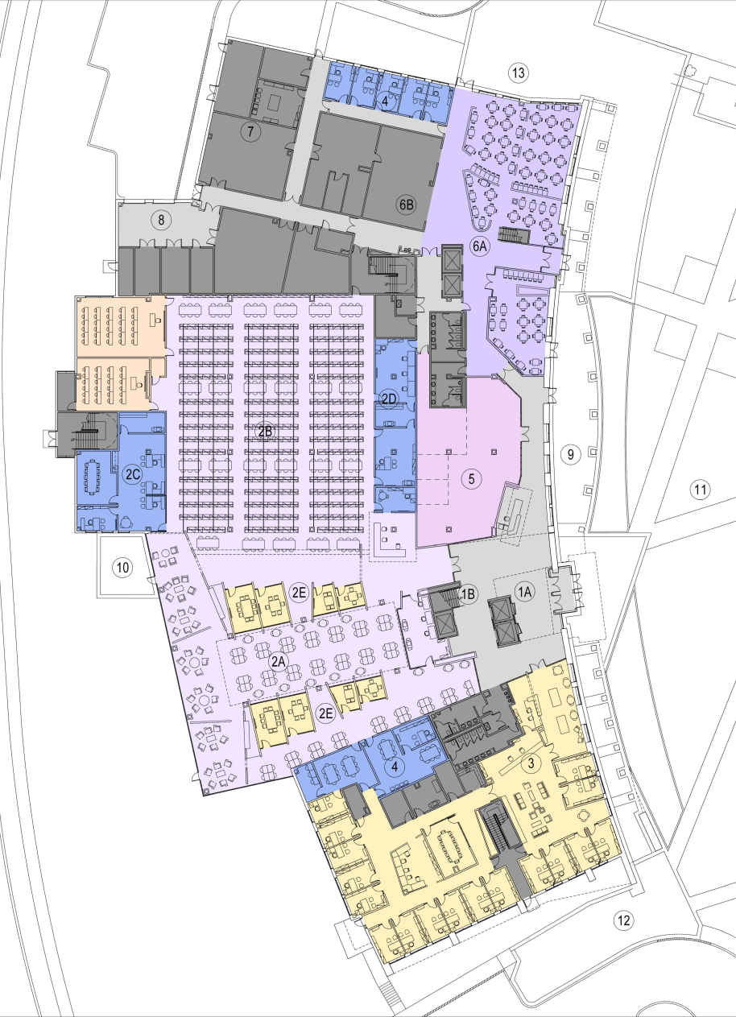
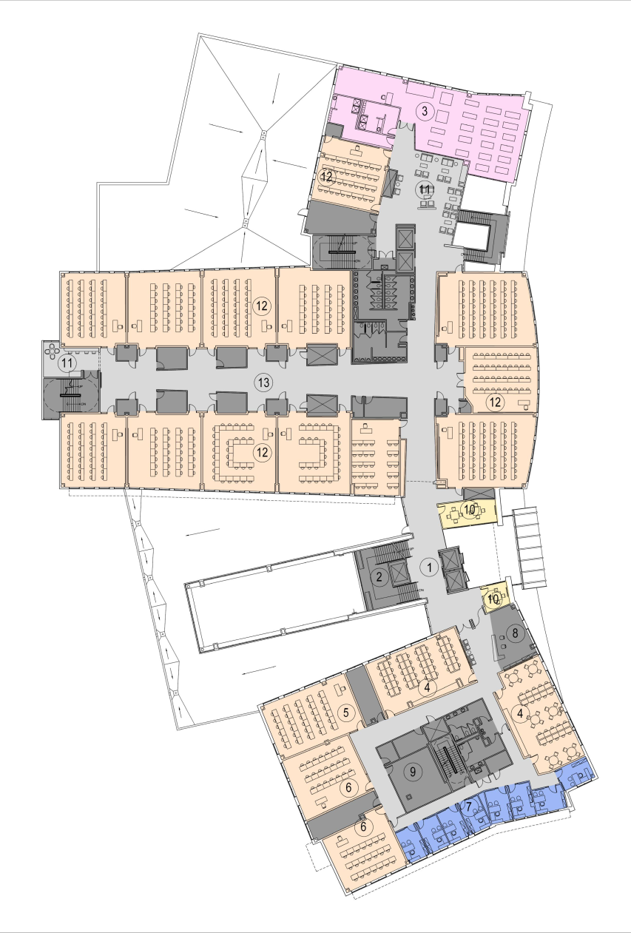
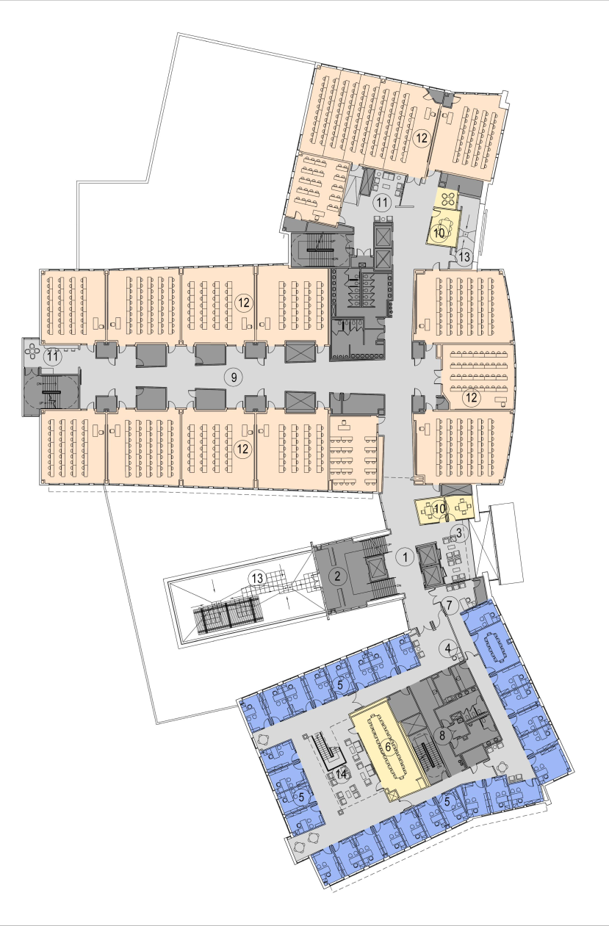
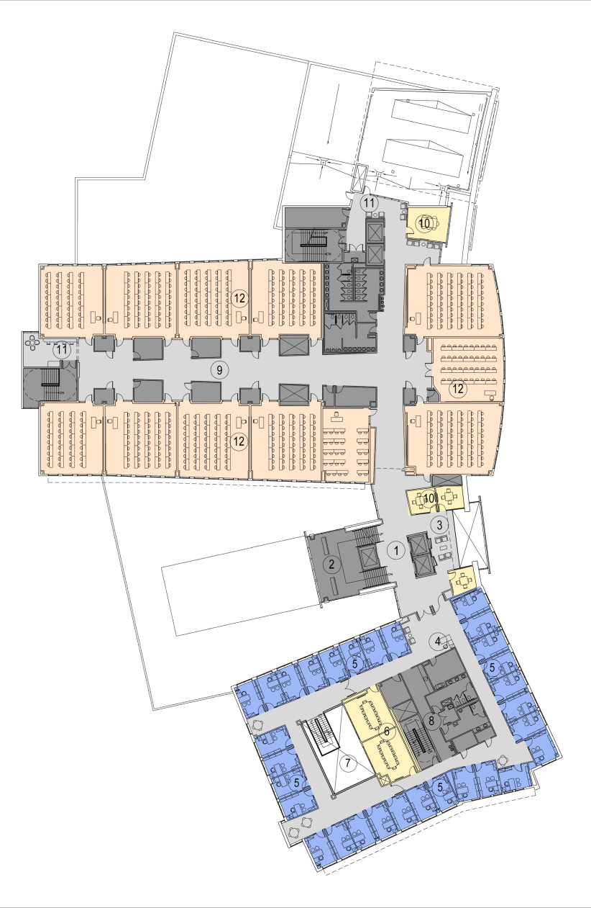
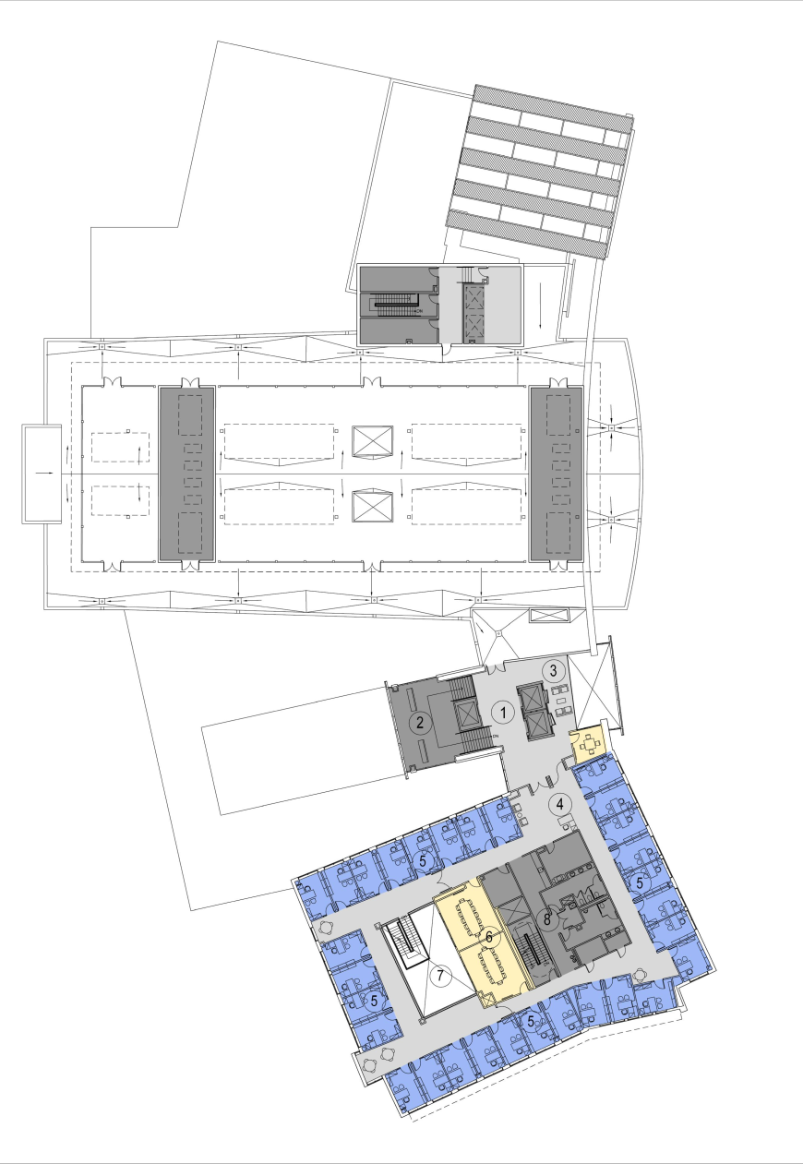
University Academic Center
Introduction
  General Information
  Building Layout
  Current Structure
Proposed Goals
Structural Depth
Construction Breadth
Conclusion
Ground Floor
Second Floor
Third Floor
Forth Floor
Fifth Floor

Slide 4
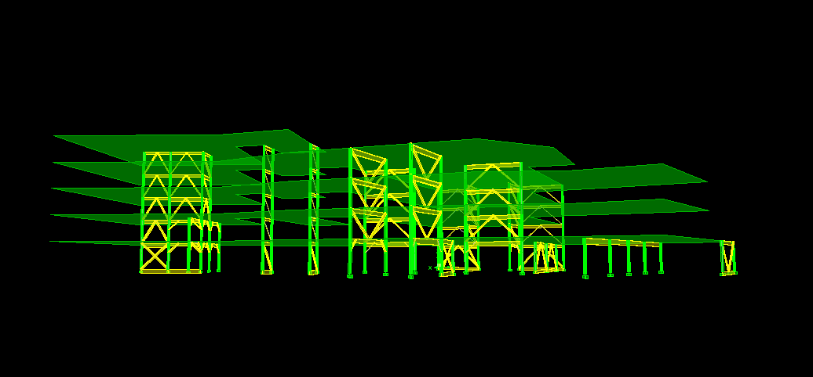
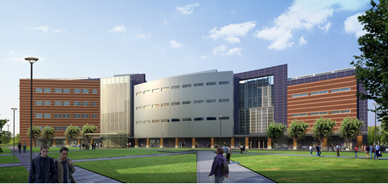
University Academic Center
Current Structure
Brick, stone, and metal panel façade
Spread footing foundation
Composite metal deck floor system
  2” 20 gauge deck with 3.25” LWC topping (typical)
Wide flange framing members
Concentrically braced frames for lateral support
  HSS members for diagonal bracing
Introduction
  General Information
  Building Layout
  Current Structure
Proposed Goals
Structural Depth
Construction Breadth
Conclusion

Slide 5
University Academic Center
Introduction
Proposed Goals
Structural Depth
Construction Breadth
Conclusion
Proposed Goals
Redesign office wing as separate concrete structure
Minimize changes to current building form
Strengthen foundations as needed
Construction breadth
  Cost and schedule reports of structures
Lighting breadth (not included in this presentation)
  Redesign lighting of computer lab space

Slide 6
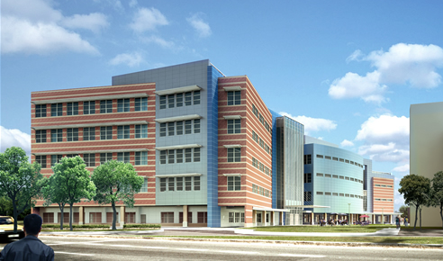
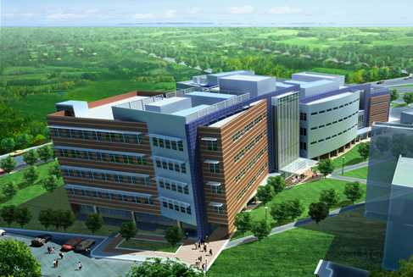
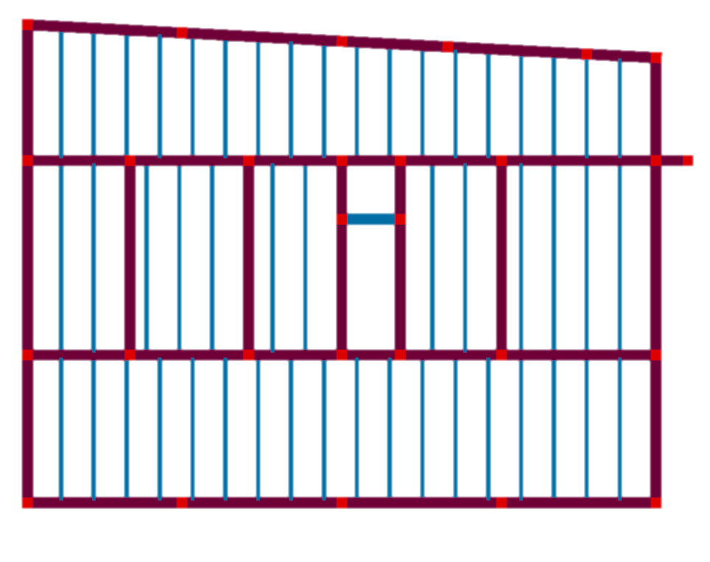
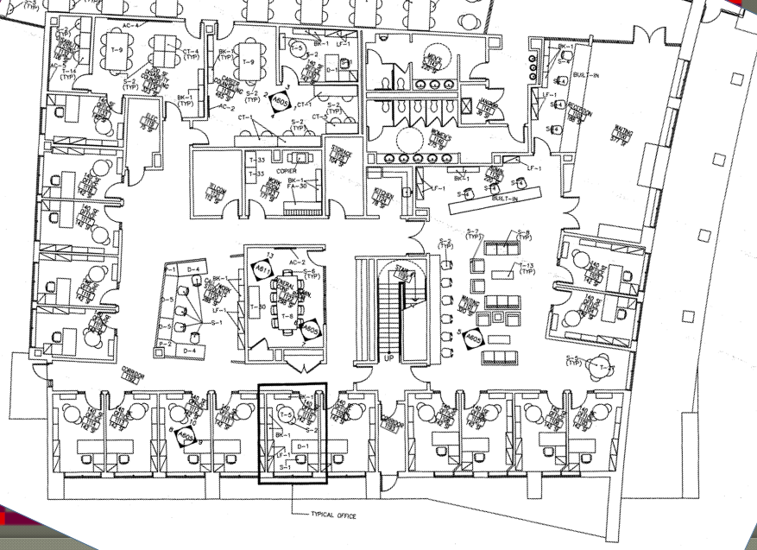


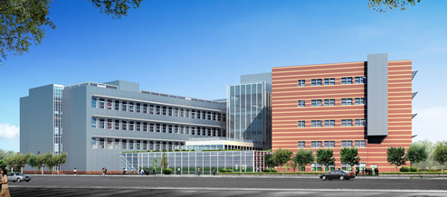
University Academic Center
Introduction
Proposed Goals
Structural Depth
  Redesign Overview
  Loads and Forces
  Drift Analysis
  Member Sizes and Reinforcement
Construction Breadth
Conclusion
Redesign Overview
5” one-way slab
One-way pan joists
Ordinary moment frames
Material Properties
Normal weight concrete
f’c = 5,000psi
fy = 60,000psi

Slide 7
University Academic Center
Introduction
Proposed Goals
Structural Depth
  Redesign Overview
  Loads and Forces
  Drift Analysis
  Member Sizes and Reinforcement
Construction Breadth
Conclusion
Live Loads
Description | Designed Load (psf) | ASCE 7-10 Load (psf)
Slab on grade | 100 | 100
Offices | 50 + 20 (partitions) | 50 + 15 (partitions)
Corridors (elevated floors) | 80 | 80
Stairs | 100 | 100
Roof | 30 | 20
Wind Forces (E-W)
Wind Forces (N-S)
25.63 k
31.79 k
49.77 k
61.74 k
48.10 k
59.67 k
45.97 k
57.02 k
45.76 k
56.76 k
215.24 k
266.98 k
8,959.68 k-ft
11,114.04 k-ft
Design Loads
Superimposed load for MEP designed for 20 psf
All floors designed for 80 psf live load
Roof designed for 30 psf live load
Wind and seismic loads recalculated for new structure
Seismic Forces (N-S) & (E-W)
99.75 k
90.20 k
66.10 k
44.52 k
22.45 k
323.02 k
17,016.8 k-ft

Slide 8
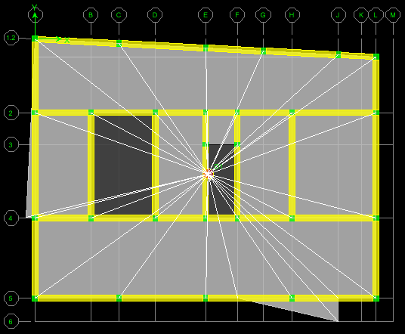
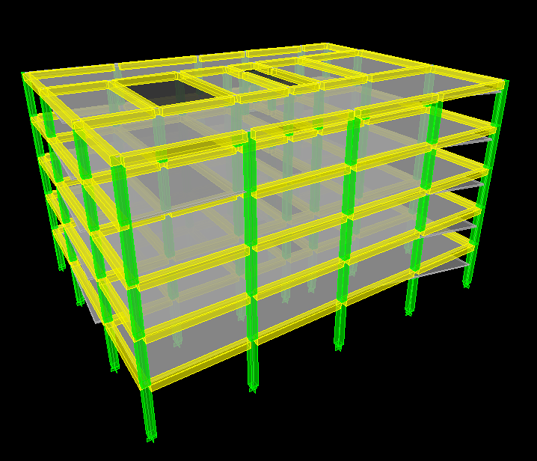
University Academic Center
Drift Analysis using ETABS
Input parameters
  Diaphragms modeled as rigid
  Mass lumped to diaphragms
  Supports assumed fixed
  Icr = 0.35 Ig for beams
  Icr = 0.7 Ig for columns
Office Wing Story Drifts (Wind)
Floor | Story Height (ft) | Drift X (in.) | Drift Y (in.) | Allowable Drift (in.) | Pass?
Roof | 14 | 0.002 | 0.098 | 0.42 | YES
5 | 14 | 0.003 | 0.171 | 0.42 | YES
4 | 14 | 0.055 | 0.250 | 0.42 | YES
3 | 14 | 0.070 | 0.301 | 0.42 | YES
2 | 16 | 0.052 | 0.237 | 0.48 | YES
Total | 72 | 0.24 | 1.06 | 2.16 | YES
Introduction
Proposed Goals
Structural Depth
  Redesign Overview
  Loads and Forces
  Drift Analysis
  Member Sizes and Reinforcement
Construction Breadth
Conclusion
Office Wing Story Drifts (Seismic)
Floor | Story Height (ft) | Amplified Drift X (in.) | Amplified Drift Y (in.) | Allowable Drift (in.) | Pass?
Roof | 14 | 0.051 | 0.598 | 2.52 | YES
5 | 14 | 0.084 | 0.900 | 2.52 | YES
4 | 14 | 0.110 | 1.144 | 2.52 | YES
3 | 14 | 0.126 | 1.211 | 2.52 | YES
2 | 16 | 0.088 | 0.860 | 2.88 | YES
Total | 72 | 0.475 | 4.725 | 12.96 | YES
N
N

Slide 9
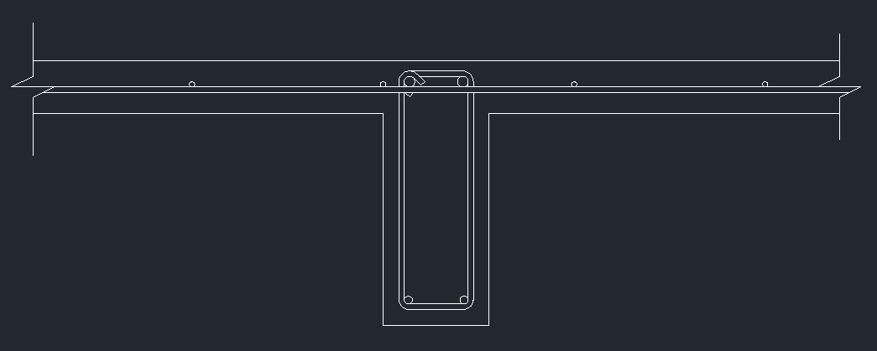
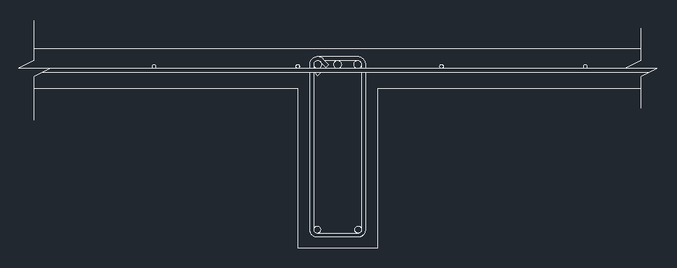
Slab Design
Minimum thickness for deflections: 2.4”
Minimum thickness for 2hr fire rating: 5”
Minimum cover: ¾”
  Use 5” slab with: #4s @ 8” o.c. for flexure
            #4s @ 18” o.c. for shrinkage & temperature
Joist Design
Minimum depth for deflections: 19.75”
Minimum cover: 1.5”
  Use pan joists: 20” pan depth, 10” rib width, 66” pan width
    with: 3-#8s top (interior span)
    2-#7s bottom (interior span)
    2-#8s top (exterior spans)
    2-#6s bottom (exterior spans)
University Academic Center
Introduction
Proposed Goals
Structural Depth
  Redesign Overview
  Loads and Forces
  Drift Analysis
  Member Sizes and Reinforcement
Construction Breadth
Conclusion
Exterior span
Interior span

Slide 10
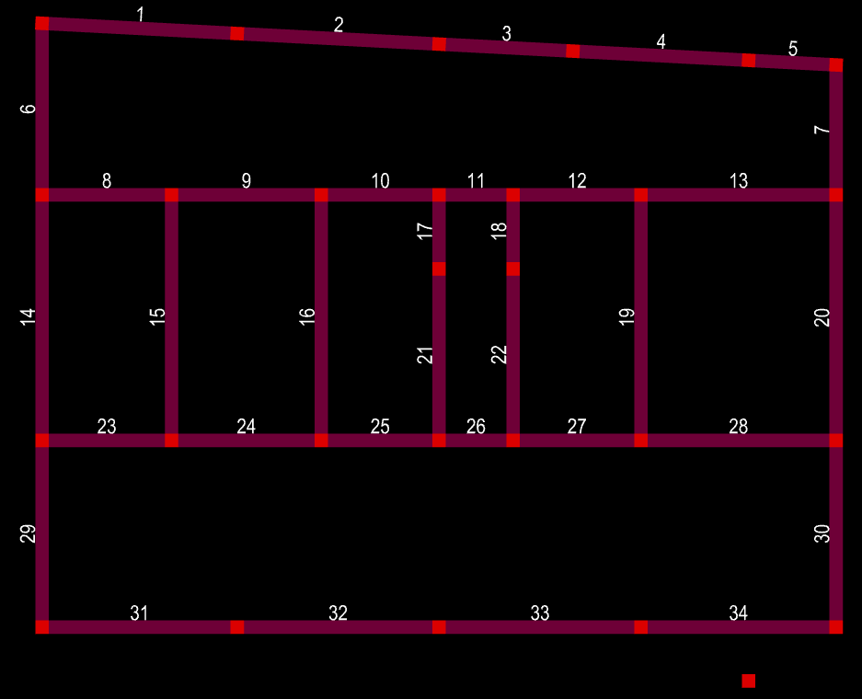
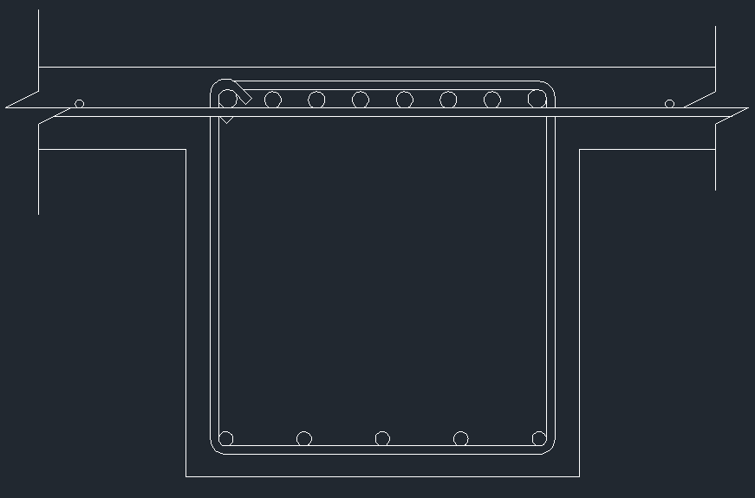
University Academic Center
Seismic Design Category B
  Ordinary concrete moment frames
  Two continuous bars both top and bottom reinforcement
Lateral Beam Design
All beams are 25”x24” to match joist depth and column width for constructability
Reinforcement done for 2nd floor and repeated on other floors
Reinforcement economized for weight
Seismic forces controlled for all members except beams 13 and 28
As,req ranged from 1.91in² (the minimum required steel) to 6.65in²
Introduction
Proposed Goals
Structural Depth
  Redesign Overview
  Loads and Forces
  Drift Analysis
  Member Sizes and Reinforcement
Construction Breadth
Conclusion
Top:
6-#8s & 2-#9s (2 bars continuous)
Bottom:
5-#7s (2 bars continuous)

Slide 11
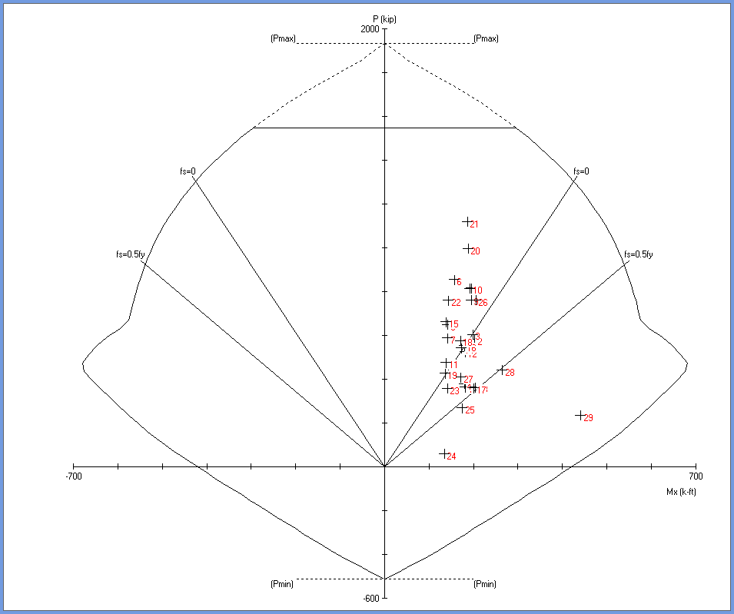
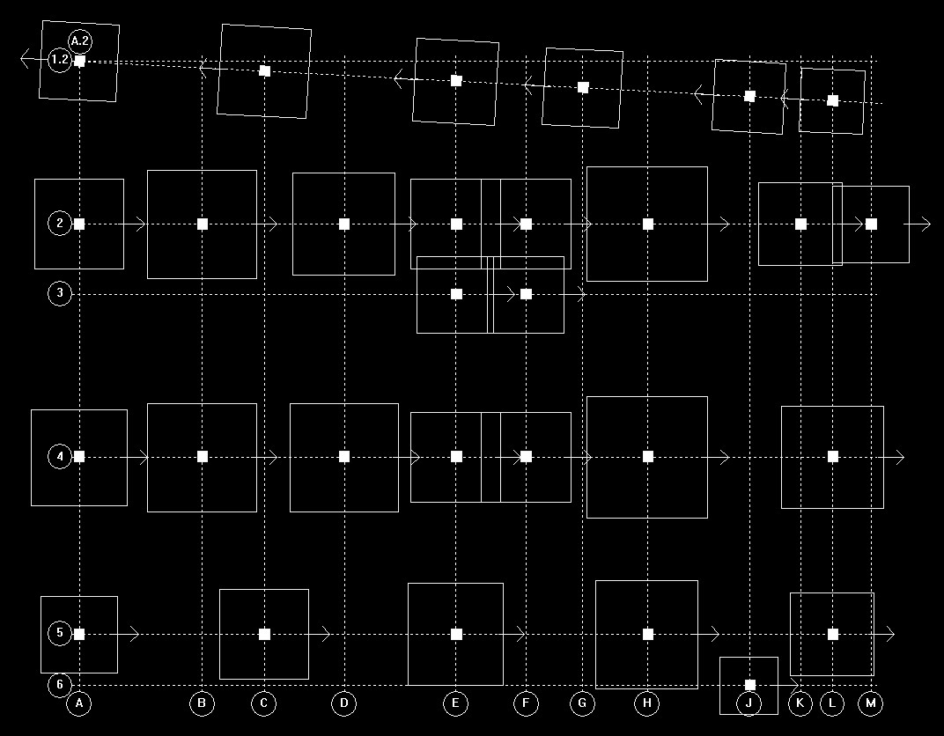
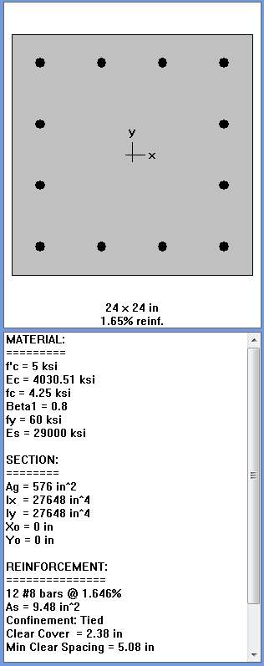
Column Design
All columns designed the same
24”x24” to minimize impact of interior spaces
12-#8s reinforcement
  Foundation Impact
  RAM foundation was used to design new foundations
  Soil bearing capacity of 3,000 psf
  Sizes increased as expected
  New footings still reasonably sized
  Combined footings needed under stairwell
University Academic Center
Introduction
Proposed Goals
Structural Depth
  Redesign Overview
  Loads and Forces
  Drift Analysis
  Member Sizes and Reinforcement
Construction Breadth
Conclusion

Slide 12
University Academic Center
New Office Wing Design Costs
 | Material | Labor | Equipment | Total | Total with O&P
Formwork | $172,235.55 | $407,588.51 | $0.00 | $579,824.06 | $815,942.64
Rebar | $153,558.67 | $108,194.27 | $0.00 | $261,752.94 | $342,390.60
Concrete | $252,822.92 | $53,140.34 | $15,985.59 | $321,948.85 | $376,821.90
Finishing | $0.00 | $11,722.32 | $0.00 | $11,722.32 | $17,583.48
Total | $578,617.14 | $580,645.43 | $15,985.59 | $1,175,248.16 | $1,552,738.62
Introduction
Proposed Goals
Structural Depth
Construction Breadth
  Steel vs. Concrete Structure Cost Reports
  Steel vs. Concrete Structure Schedules
Conclusion
Steel vs. Concrete Cost Summary
Cost summary only includes areas of design that were changed as part of the concrete redesign
Cost based off unit costs in RSMeans 2012
Steel is $361,969.52 more expensive than concrete
Original Office Wing Design Costs
 | Material | Labor | Equipment | Total | Total with O&P
Formwork | $1,670.70 | $8,703.78 | $0.00 | $10,374.48 | $15,224.89
Reinforcing | $24,621.93 | $19,828.88 | $0.00 | $44,450.81 | $58,945.93
Concrete | $146,751.02 | $18,422.33 | $5,011.77 | $170,185.12 | $194,658.14
Finishing | $0.00 | $11,722.32 | $0.00 | $11,722.32 | $17,583.48
Shear Studs | $4,189.50 | $6,247.50 | $3,013.50 | $13,450.50 | $19,110.00
Steel Framing | $1,010,429.31 | $173,036.06 | $49,631.94 | $1,233,097.31 | $1,467,798.24
Metal Deck | $1,511.39 | $21,970.86 | $1,608.43 | $114,473.37 | $141,387.47
Total | $1,189,173.85 | $259,931.72 | $59,265.64 | $1,597,753.90 | $1,914,708.14

Slide 13
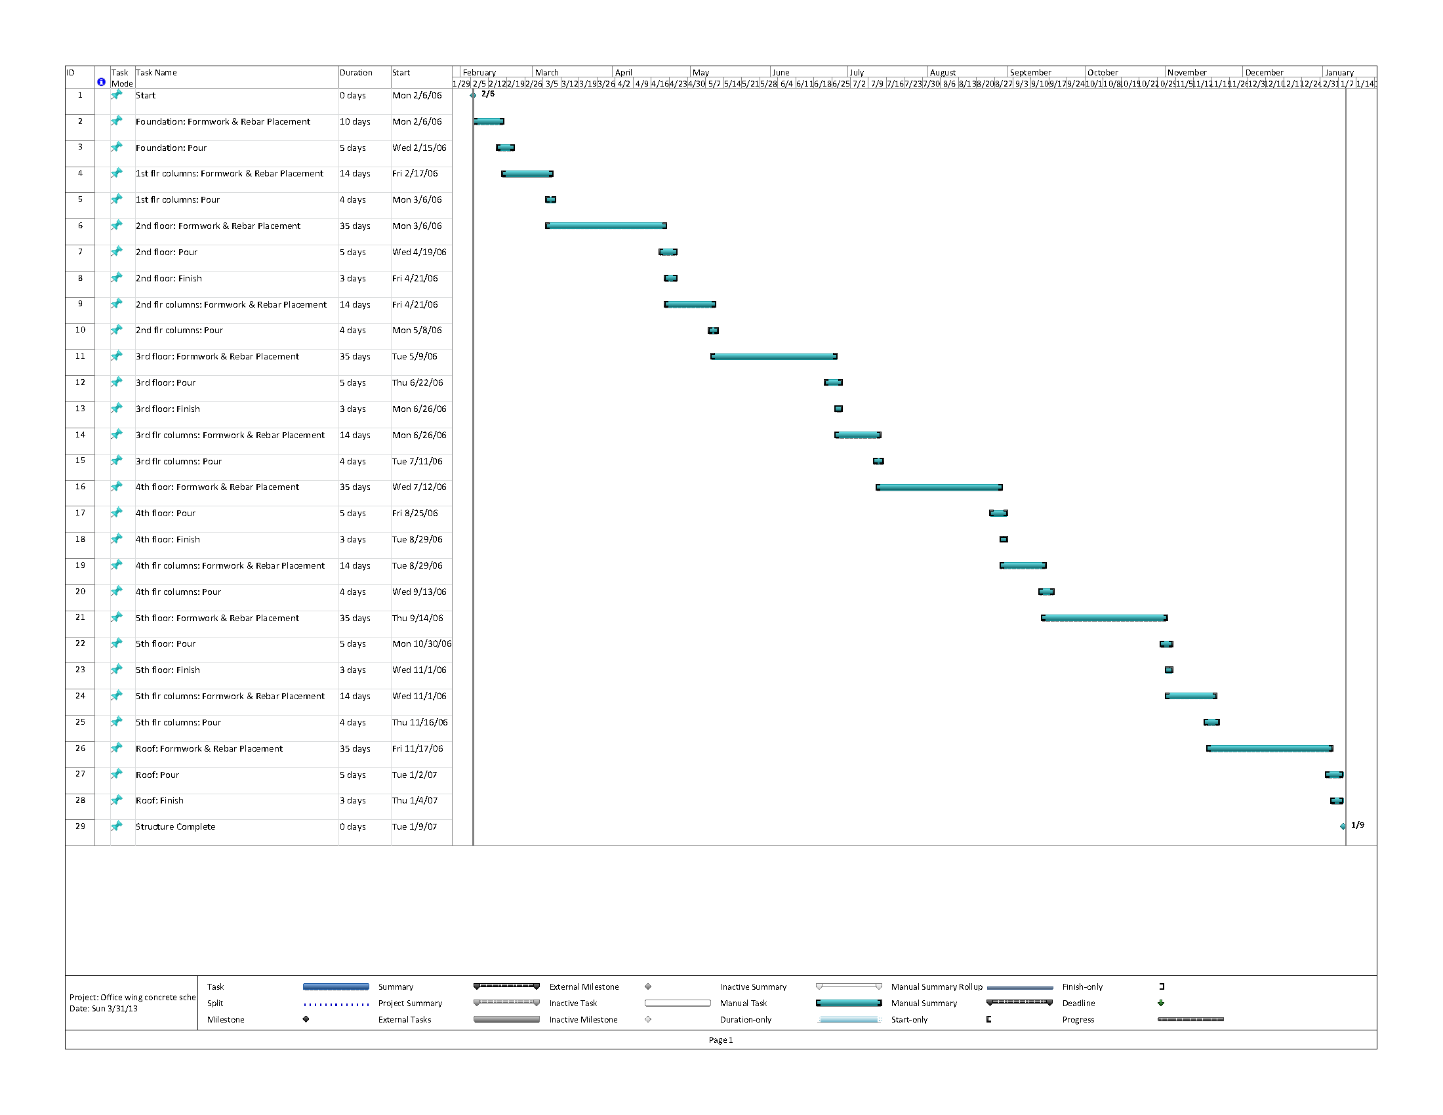
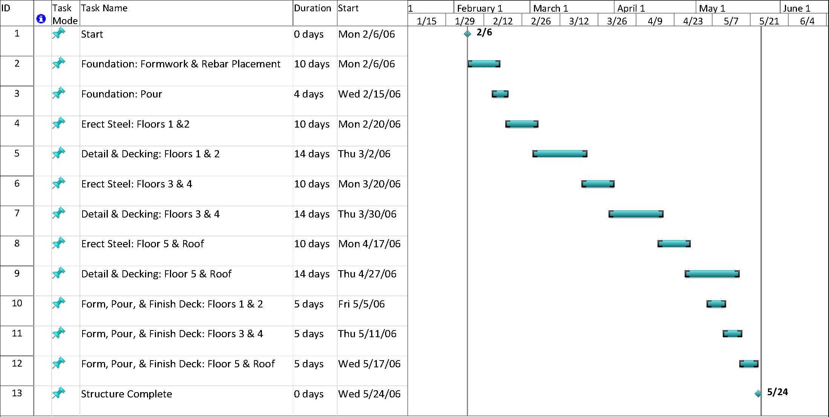
University Academic Center
Steel vs. Concrete Schedule Summary
Durations also calculated using RSMeans 2012
Concrete design is scheduled to take 230 days longer than original steel
Introduction
Proposed Goals
Structural Depth
Construction Breadth
  Steel vs. Concrete Structure Cost Reports
  Steel vs. Concrete Structure Schedules
Conclusion
Steel Schedule: 2/6/06 – 5/24/06
Total duration: 107 days
Concrete Schedule: 2/6/06 – 1/9/07
Total duration: 337 days

Slide 14
University Academic Center
Review
Concrete redesign of office wing
  One-way pan joist floor system
  Ordinary concrete moment frame lateral system
Seismic forces controlled lateral design
No disrupting of spaces due to new column layout
Floor-to-floor heights remain unchanged
Introduction
Proposed Goals
Structural Depth
Construction Breadth
Conclusion
  Review and Recommendations
  Questions?
Recommendations
Further analysis to minimize member sizes on upper floors
Redesign the original structure without the office wing
Conclusions
Concrete moment frames offer a “free” lateral system with minimal additions as opposed to a steel braced frame system

Slide 15
University Academic Center
Questions & Comments?
Acknowledgements
Thank you to the following groups and individuals for their continued support in completing this thesis report:
  The Owner (who wished to remain anonymous)
  Skanska USA Building Inc.
  The entire AE faculty
  The entire AE student body (especially fellow 5th years)
  My friends and family
Introduction
Proposed Goals
Structural Depth
Construction Breadth
Conclusion
  Review and Recommendations
  Questions?

Slide 16
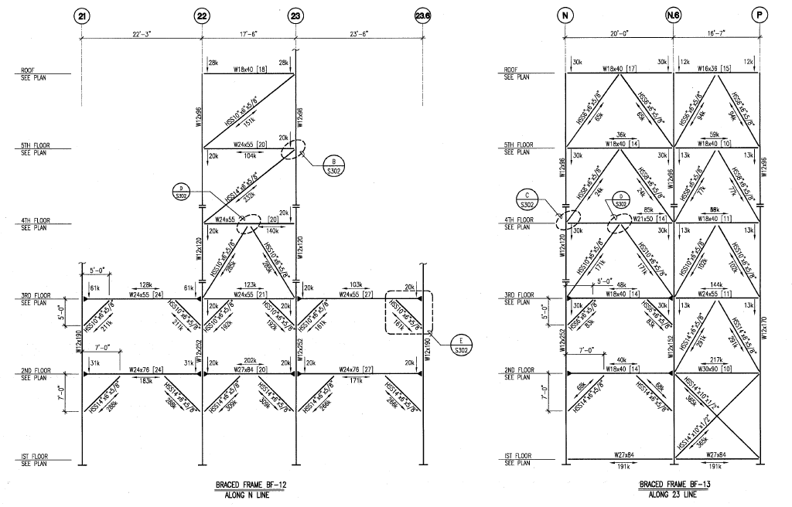
University Academic Center
Additional slides

Slide 17
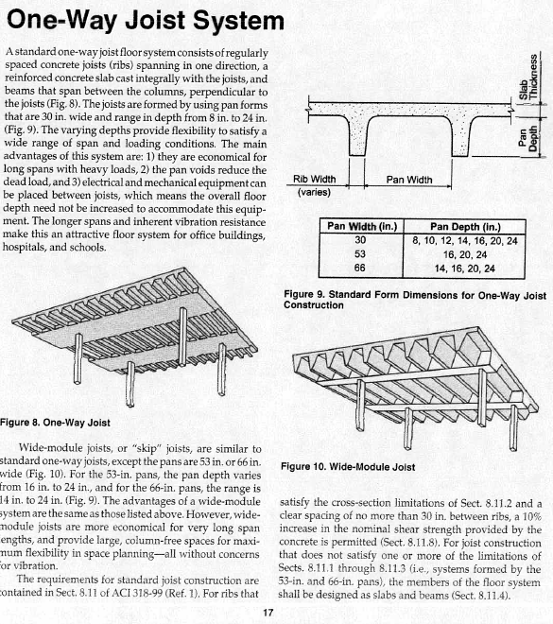
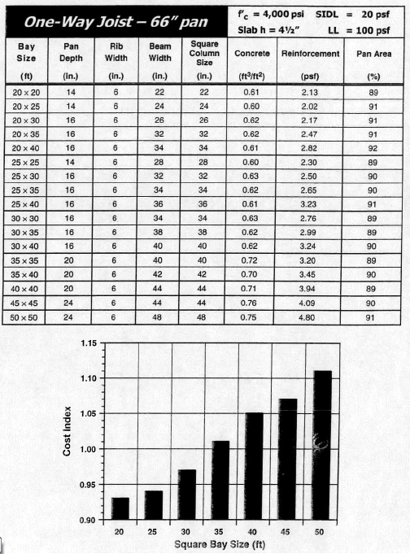
University Academic Center
Concrete Floor Systems
Guide to Estimating and Economizing
David A. Fanella
Additional slides

Slide 18
University Academic Center
Additional slides

Slide 19
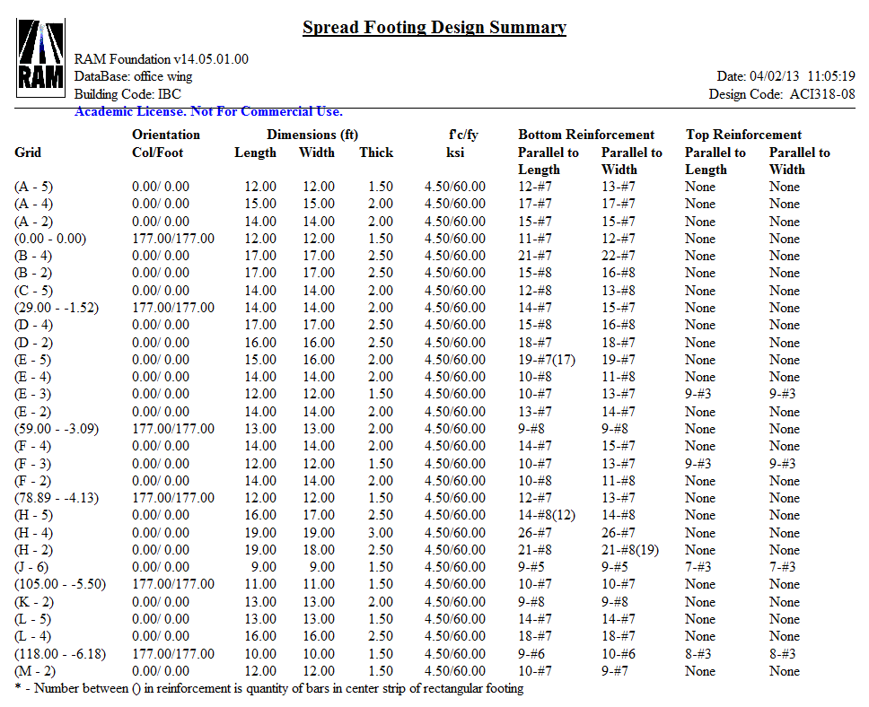
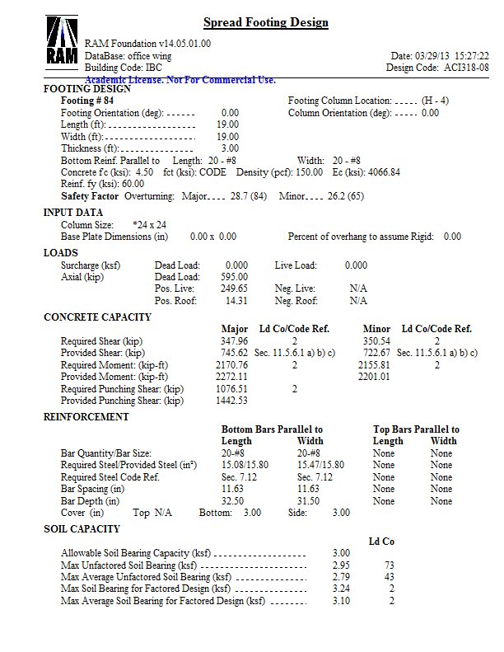
University Academic Center
Additional slides

Slide 20
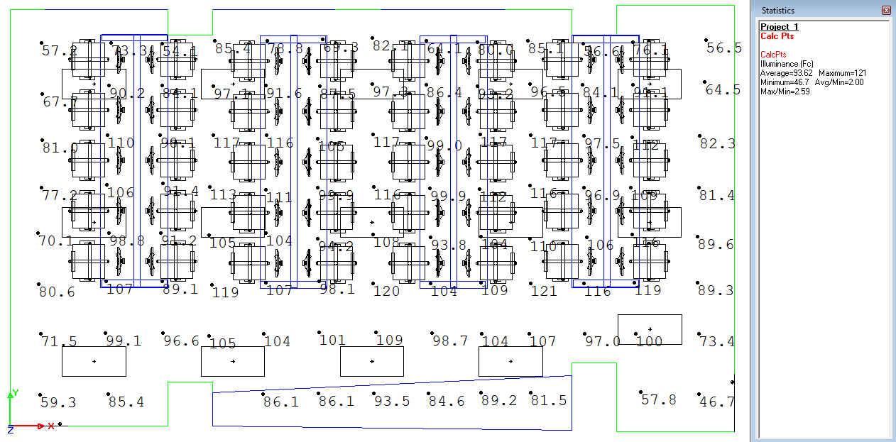
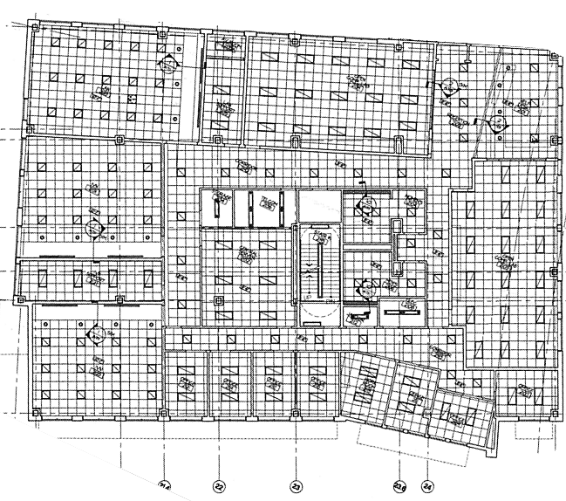
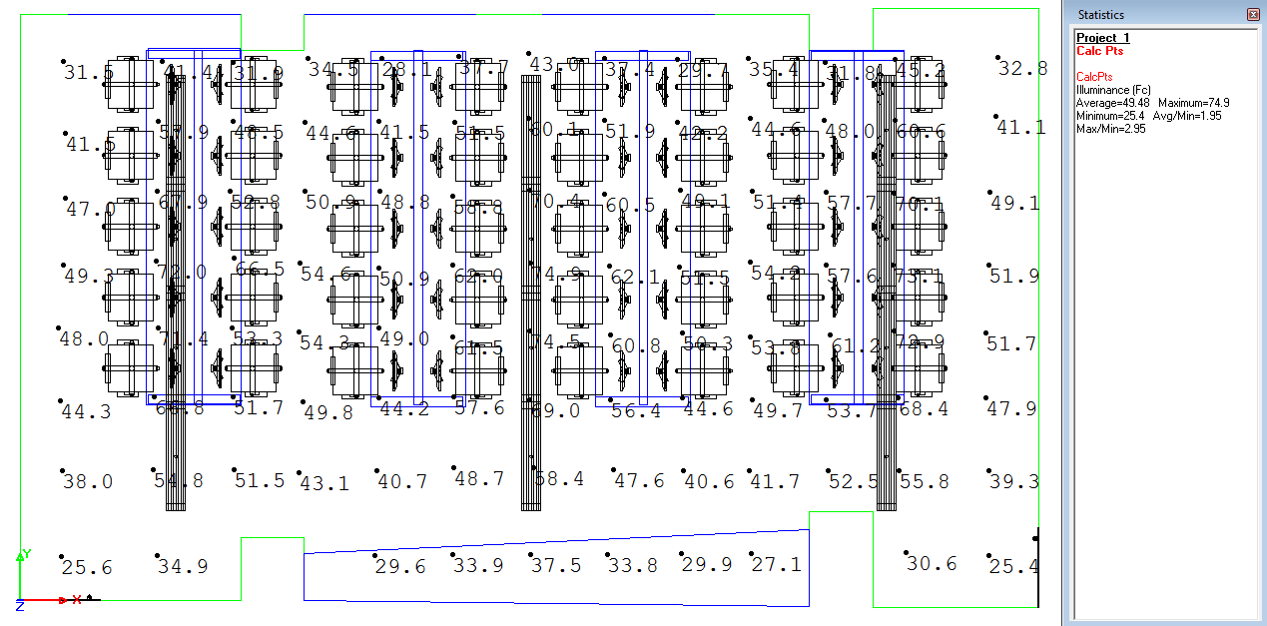
University Academic Center
Original recessed lighting
Additional slides
Reflected Ceiling Plan
Computer Lab Room 2139
New pendant lighting

